Slide 1
Big Mountain Resort Presentation
By: Andrew Stoker
Date: February 6th, 2024

Slide 2
Agenda
Problem identification
Key Findings & Recommendations
Modeling Results and Analysis
Summary/Conclusion

Slide 3
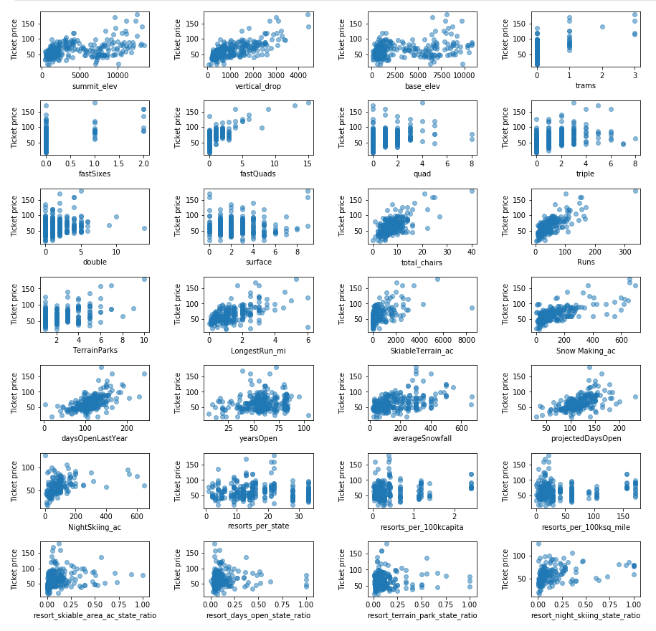
Problem Identification
Problem was first presented by executive team members
Main issue: How should Big Mountain Resort change their operations so they can profit after installing a new chair lift?
Some solutions were presented, but a best-fit solution had not yet been discovered.
Data wrangling and exploratory analysis gave better insight on the trajectory of the current data and of this project.
Exploratory Correlations

Slide 4
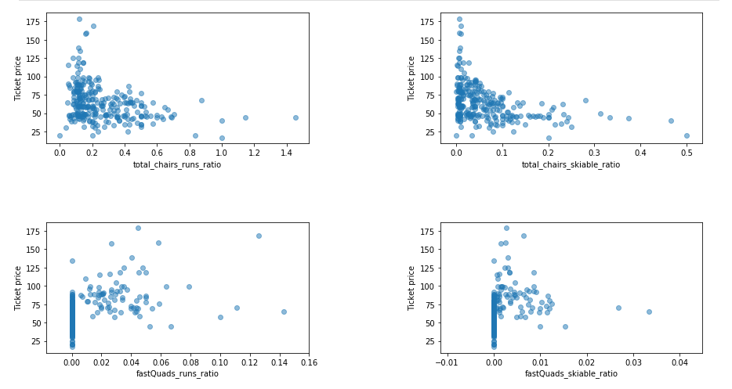
Problem Identification Major Findings

Slide 5
Key Findings & Recommendations
4 scenarios were evaluated:
1.) Closing Less Used Runs: Shutting down up to 10 of the least utilized runs was considered. Closing one run has no impact on ticket price, suggesting closing up to 5 runs may not decrease revenue.
2.) Adding Features: Adding a run, increasing vertical drop by 150 feet, and installing another chair lift could raise ticket prices by $1.99. With 350,000 visitors purchasing 5 tickets each, this change could increase revenue by $3,474,648.
3.) Enhanced Features: Adding 2 acres of snowmaking coverage alongside the changes in scenario 2 didn't affect ticket prices or revenue.
4.) Snowmaking and Run Length Increase: Increasing snowmaking to 3.5 acres and the longest run to 3.5 miles didn't alter ticket prices.
Scenario 2 appears promising, with an estimated revenue increase of $3,474,648. While the operating cost for a new chair lift is known ($1,540,000), costs for adding a run and increasing vertical drop aren't specified. Assuming only the chair lift cost, scenario 2 could generate an additional $1,934,648 in revenue. Further analysis is needed to ascertain the feasibility and profitability of this scenario.

Slide 6
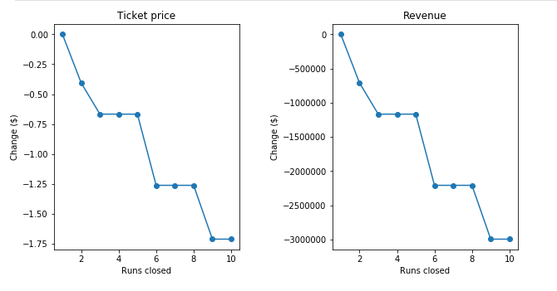
Modeling results and analysis (1)
Scenario 1
The model says closing one run makes no difference.
Closing runs 2 and 3 successively reduces support for ticket price.
If Big Mountain closes down 3 runs, it seems they may as well close down 4 or 5 since there's no further loss in ticket price. Increasing the closures down to 6 or more leads to a large drop.

Slide 7
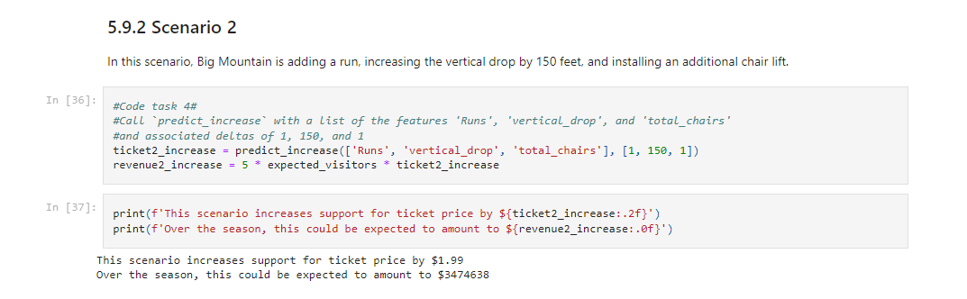
Modeling results and analysis (2)
Scenario 2
Most likely to increase revenue since it increases support for ticket price by $1.99.
Overall revenue could be $3,474,638.00

Slide 8
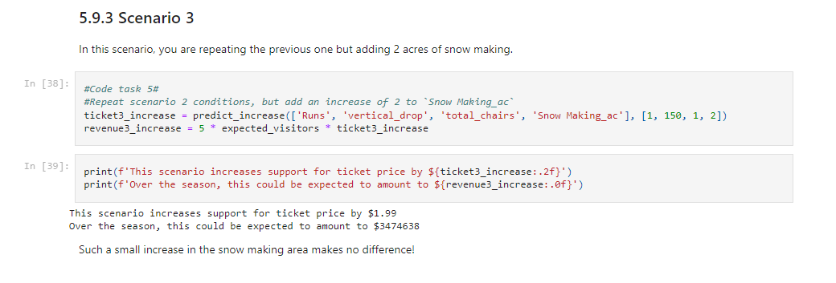
Modeling results and analysis (3)
Scenario 3
Only shows a small increase
Doesn’t seem worth it considering the expenses of adding 2 acres of snow making

Slide 9
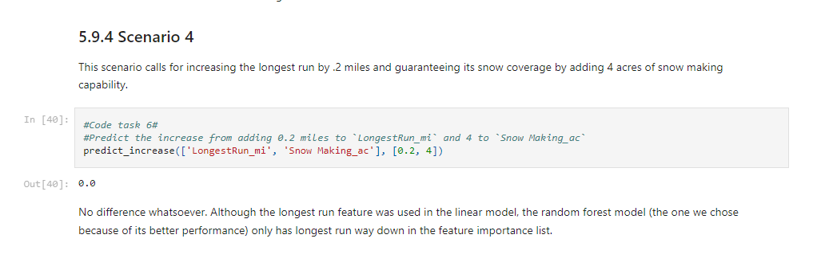
Modeling results and analysis (4)
Scenario 4
No difference at all

Slide 10
Summary/Conclusion
To make the most revenue, Big Mountain Resort should consider adding the following features to their runs:
Adding a run
Increasing vertical drop by 150 feet
Installing another chair lift
These additions would sufficiently increase ticket support to allow for a $3 million+ profit.

